Slide 1
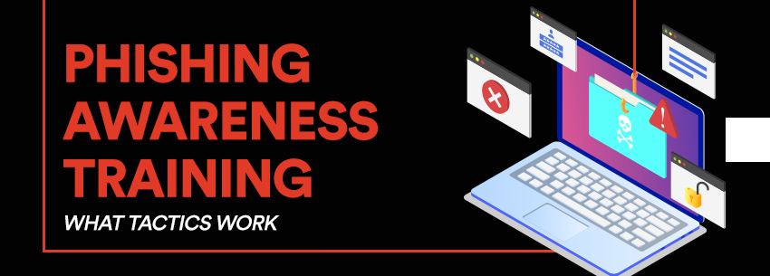
Phishing Awareness Training

Slide 2
What is Phishing?
Phishing is a cyber attack that uses disguised email, websites, or messages to trick users into revealing sensitive information.
Often appears as a trusted source like a bank, government agency, or colleague.
How It Works:
Phishing uses email, fake websites, phone calls, or messages to:
Trick users into clicking a malicious link
Get them to download malware
Convince them to enter login credentials

Slide 3
Types of Phishing Attacks
Email Phishing: Mass emails with malicious links/attachments.
Spear Phishing: Targeted phishing emails.
Smishing: Phishing via SMS.
Vishing: Voice phishing via phone calls.
Whaling: Targeting senior executives.
Clone Phishing: Replica of a legitimate message with a malicious link.

Slide 4
Recognizing Phishing Emails
Generic greetings (e.g., "Dear Customer")
Spelling and grammar mistakes
Mismatched or suspicious email addresses
Threatening language or urgency
Unexpected attachments or links
Requests for Personal Information
Suspicious Formatting or Logos

Slide 5
Recognizing Fake Websites
Check for HTTPS and the correct domain name
Beware of pop-ups asking for credentials
Poor design or odd formatting
URLs with strange characters or subdomains
Fake Pop-Ups Asking for Login Info
Low-Quality Design or Layout
Unexpected Redirects
Too Many Ads or Download Prompts

Slide 6
Social Engineering Tactics
Urgency: Act now or lose access!
Fear: Your account will be deleted!
Greed: You've won a prize!
Trust: Posing as a known contact or authority
Curiosity: Check this shocking news!
Authority : Pretending to be a boss, police, or IT support

Slide 7
Best Practices to Stay Safe
Don't click suspicious links or attachments
Verify email sender addresses
Use two-factor authentication (2FA)
Keep software and antivirus updated
Report phishing attempts to your IT/security team
Verify Websites Before Entering Data
Stay Informed and Think Before You Act
Never Share Sensitive Info Over Untrusted Channels

Slide 8
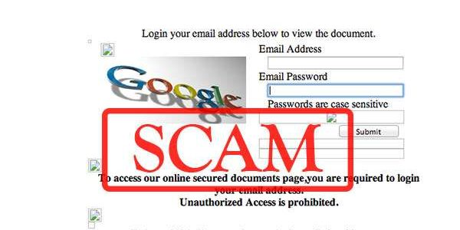
Real-World Examples
Google Docs Scam (2017): Looked like a file share invitation
Netflix Account Suspension Phishing: Faked login page

Slide 9
Interactive Quiz
Q1: What is phishing?
a) A way to catch fish online b) A technique to speed up internet ✅ c) A cyber attack using fake emails and websites d) A method for improving password strength
Q2: What should you do if you receive a suspicious email with a link?
a) Click it to check b) Forward it to others ✅ c) Report it to IT/security and delete it d) Reply asking for more info
Q3: Which type of phishing targets a specific person or organization?
a) Smishing ✅ b) Spear Phishing c) Clone Phishing d) Vishing

Slide 10
Interactive Quiz
Q4: What is smishing?
a) Phishing through email b) Phishing through voice calls ✅ c) Phishing through SMS/text messages d) Phishing on social media
Q5: Which is a legitimate-looking domain likely used in phishing?
a) google.com ✅ b) gooogle-login.com c) gmail.com d) google.co.in
Q6: What should you do after clicking on a phishing link by mistake
a) Restart your computer ✅ b) Disconnect from internet and report to IT/security c) Ignore it d) Forward the link to friends to warn them

Slide 11
Conclusion
Phishing continues to be a major threat in today’s digital world, exploiting human psychology more than technical vulnerabilities. Attackers are becoming more creative, crafting realistic emails, SMS, and websites that can trick even cautious users.
But awareness is the first line of defense.
By understanding how phishing works and recognizing the warning signs, individuals and organizations can significantly reduce their risk. Education and vigilance are key.

